Slide 1
Kafka introduction
Robert lee

Slide 2
Agenda
What is Kafka?
Why we need to import Kafka in our project?
What are the pros and cons?
What are the difference comparing with other MQs?
Design
Topic and Partition
Commit Log and Line Write
Consumer Group and Consumer

Slide 3
Apache Kafka® is a distributed streaming platform
A streaming platform has three key capabilities:
Publish and subscribe to streams of records, similar to a message queue or enterprise messaging system
Store streams of records in a fault-tolerant durable way.
Process streams of records as they occur

Slide 4
Kafka is generally used for two broad classes of applications:
Building real-time streaming data pipelines that reliably get data between systems or applications
Building real-time streaming applications that transform or react to the streams of data

Slide 5
Kafka is run as a cluster on one or more servers that can span multiple datacenters.
The Kafka cluster stores streams of records in categories called topics.
Each record consists of a key, a value, and a timestamp.

Slide 6
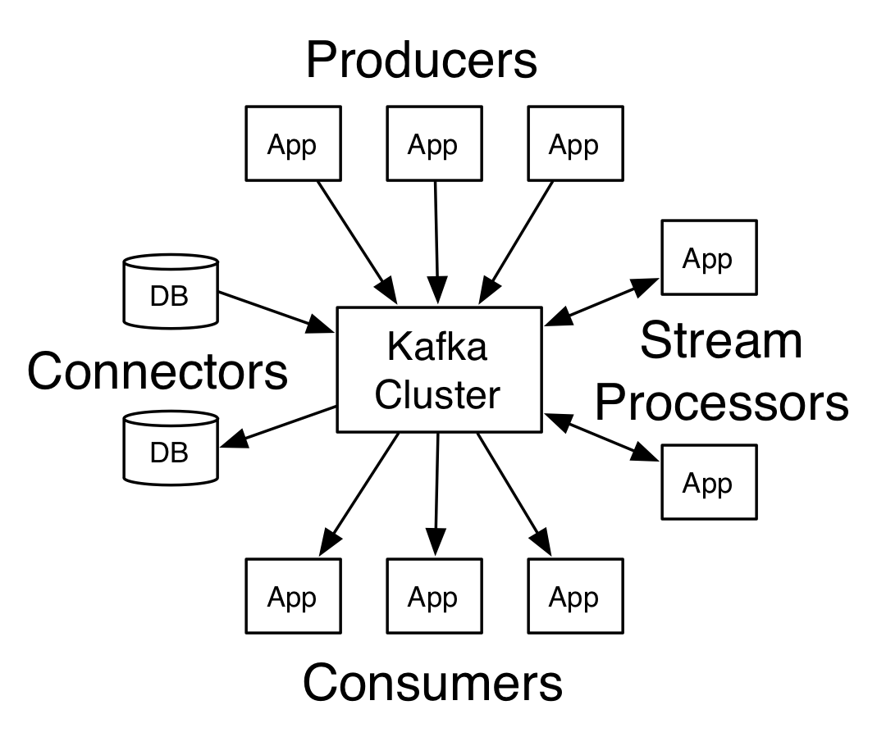

Slide 7
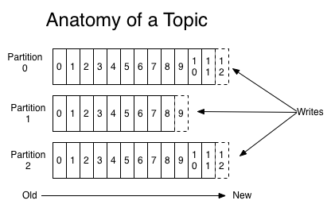
Topics and Logs
Let's first dive into the core abstraction Kafka provides for a stream of records—the topic.
A topic is a category or feed name to which records are published. Topics in Kafka are always multi-subscriber; that is, a topic can have zero, one, or many consumers that subscribe to the data written to it.
For each topic, the Kafka cluster maintains a partitioned log that looks like this:

Slide 8
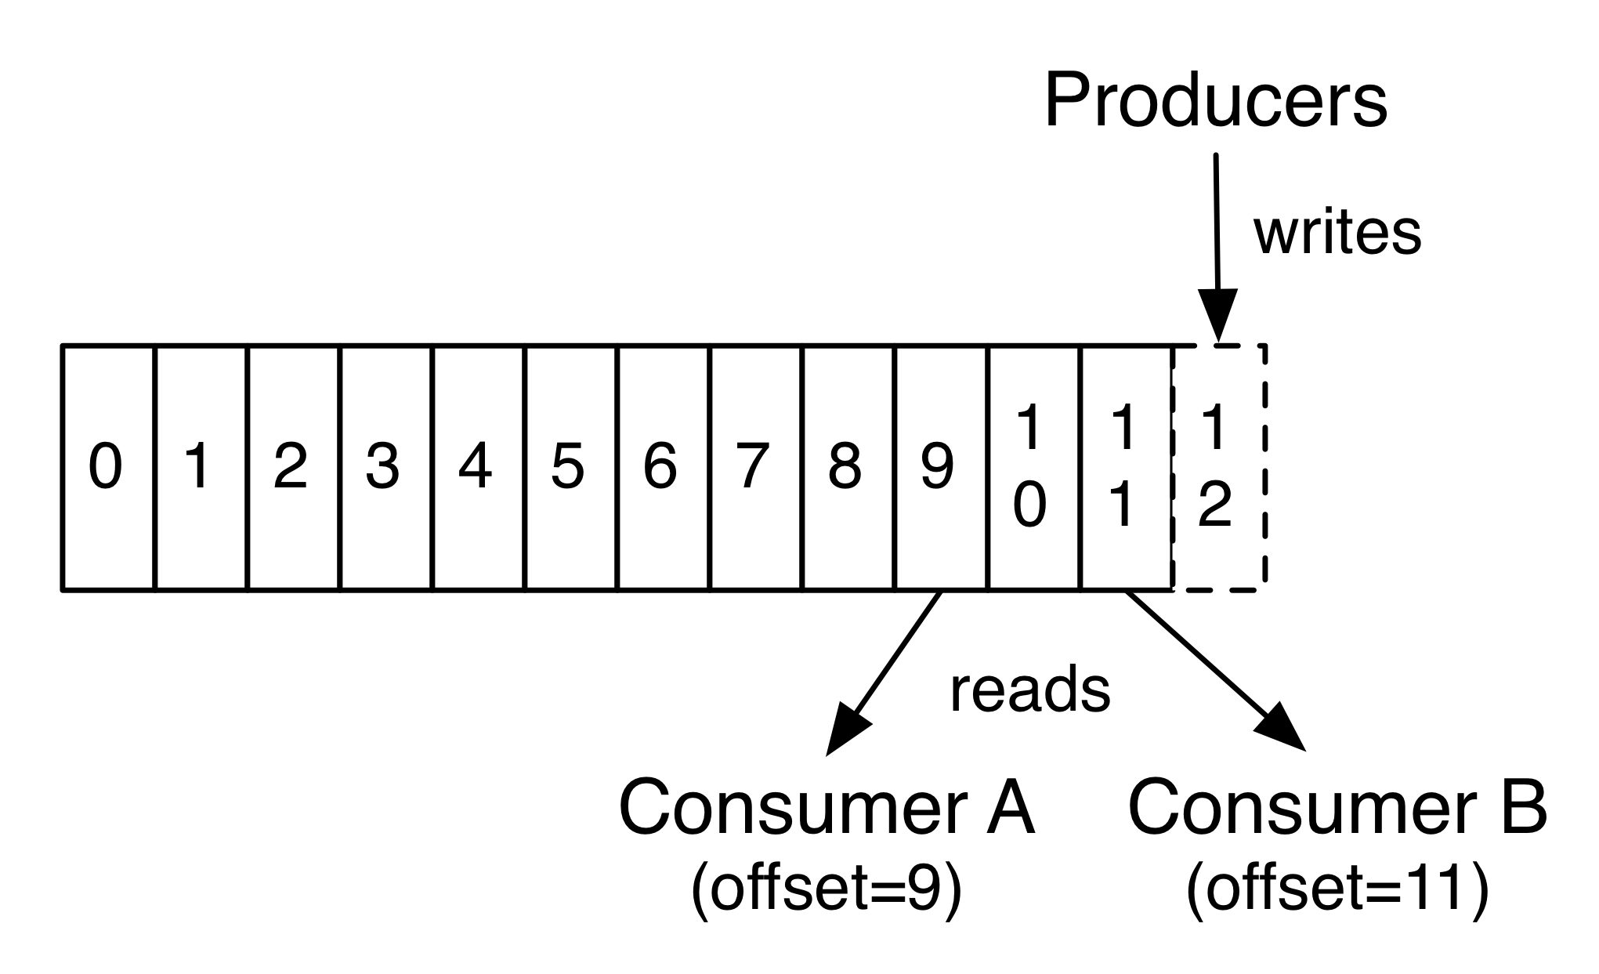
Each partition is an ordered, immutable sequence of records that is continually appended to—a structured commit log. The records in the partitions are each assigned a sequential id number called the offset that uniquely identifies each record within the partition.
The Kafka cluster durably persists all published records—whether or not they have been consumed—using a configurable retention period. For example, if the retention policy is set to two days, then for the two days after a record is published, it is available for consumption, after which it will be discarded to free up space. Kafka's performance is effectively constant with respect to data size so storing data for a long time is not a problem.

Slide 9
In fact, the only metadata retained on a per-consumer basis is the offset or position of that consumer in the log. This offset is controlled by the consumer: normally a consumer will advance its offset linearly as it reads records, but, in fact, since the position is controlled by the consumer it can consume records in any order it likes. For example a consumer can reset to an older offset to reprocess data from the past or skip ahead to the most recent record and start consuming from "now".
This combination of features means that Kafka consumers are very cheap—they can come and go without much impact on the cluster or on other consumers. For example, you can use our command line tools to "tail" the contents of any topic without changing what is consumed by any existing consumers.

Slide 10
Distribution
The partitions in the log serve several purposes. First, they allow the log to scale beyond a size that will fit on a single server. Each individual partition must fit on the servers that host it, but a topic may have many partitions so it can handle an arbitrary amount of data. Second they act as the unit of parallelism—more on that in a bit.
Each partition has one server which acts as the "leader" and zero or more servers which act as "followers". The leader handles all read and write requests for the partition while the followers passively replicate the leader. If the leader fails, one of the followers will automatically become the new leader. Each server acts as a leader for some of its partitions and a follower for others so load is well balanced within the cluster.

Slide 11
Geo-Replication
Kafka MirrorMaker provides geo-replication support for your clusters. With MirrorMaker, messages are replicated across multiple datacenters or cloud regions. You can use this in active/passive scenarios for backup and recovery; or in active/active scenarios to place data closer to your users, or support data locality requirements.

Slide 12
Producers
Producers publish data to the topics of their choice. The producer is responsible for choosing which record to assign to which partition within the topic. This can be done in a round-robin fashion simply to balance load or it can be done according to some semantic partition function (say based on some key in the record). More on the use of partitioning in a second!
Consumers
Consumers label themselves with a consumer group name, and each record published to a topic is delivered to one consumer instance within each subscribing consumer group. Consumer instances can be in separate processes or on separate machines.
If all the consumer instances have the same consumer group, then the records will effectively be load balanced over the consumer instances.
If all the consumer instances have different consumer groups, then each record will be broadcast to all the consumer processes.

Slide 13
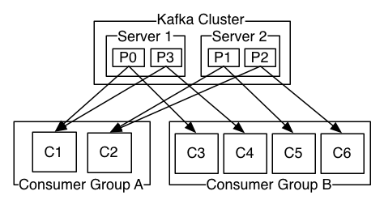

Slide 14
A two server Kafka cluster hosting four partitions (P0-P3) with two consumer groups. Consumer group A has two consumer instances and group B has four.
More commonly, however, we have found that topics have a small number of consumer groups, one for each "logical subscriber". Each group is composed of many consumer instances for scalability and fault tolerance. This is nothing more than publish-subscribe semantics where the subscriber is a cluster of consumers instead of a single process.
The way consumption is implemented in Kafka is by dividing up the partitions in the log over the consumer instances so that each instance is the exclusive consumer of a "fair share" of partitions at any point in time. This process of maintaining membership in the group is handled by the Kafka protocol dynamically. If new instances join the group they will take over some partitions from other members of the group; if an instance dies, its partitions will be distributed to the remaining instances.

Slide 15
Kafka only provides a total order over records within a partition, not between different partitions in a topic. Per-partition ordering combined with the ability to partition data by key is sufficient for most applications.
However, if you require a total order over records this can be achieved with a topic that has only one partition, though this will mean only one consumer process per consumer group.

Slide 16
Kafka as a Messaging System
Messaging traditionally has two models: queuing and publish-subscribe.
In a queue, a pool of consumers may read from a server and each record goes to one of them; in publish-subscribe the record is broadcast to all consumers. Each of these two models has a strength and a weakness.
The strength of queuing is that it allows you to divide up the processing of data over multiple consumer instances, which lets you scale your processing. Unfortunately, queues aren't multi-subscriber—once one process reads the data it's gone.
Publish-subscribe allows you broadcast data to multiple processes, but has no way of scaling processing since every message goes to every subscriber.

Slide 17
The consumer group concept in Kafka generalizes these two concepts. As with a queue the consumer group allows you to divide up processing over a collection of processes (the members of the consumer group). As with publish-subscribe, Kafka allows you to broadcast messages to multiple consumer groups.
The advantage of Kafka's model is that every topic has both these properties—it can scale processing and is also multi-subscriber—there is no need to choose one or the other.

Slide 18
A traditional queue retains records in-order on the server, and if multiple consumers consume from the queue then the server hands out records in the order they are stored. However, although the server hands out records in order, the records are delivered asynchronously to consumers, so they may arrive out of order on different consumers. This effectively means the ordering of the records is lost in the presence of parallel consumption. Messaging systems often work around this by having a notion of "exclusive consumer" that allows only one process to consume from a queue, but of course this means that there is no parallelism in processing.
Kafka does it better. By having a notion of parallelism—the partition—within the topics, Kafka is able to provide both ordering guarantees and load balancing over a pool of consumer processes. This is achieved by assigning the partitions in the topic to the consumers in the consumer group so that each partition is consumed by exactly one consumer in the group. By doing this we ensure that the consumer is the only reader of that partition and consumes the data in order. Since there are many partitions this still balances the load over many consumer instances. Note however that there cannot be more consumer instances in a consumer group than partitions.

Slide 19
Kafka as a Storage System
Any message queue that allows publishing messages decoupled from consuming them is effectively acting as a storage system for the in-flight messages. What is different about Kafka is that it is a very good storage system.
Data written to Kafka is written to disk and replicated for fault-tolerance. Kafka allows producers to wait on acknowledgement so that a write isn't considered complete until it is fully replicated and guaranteed to persist even if the server written to fails.
The disk structures Kafka uses scale well—Kafka will perform the same whether you have 50 KB or 50 TB of persistent data on the server.
As a result of taking storage seriously and allowing the clients to control their read position, you can think of Kafka as a kind of special purpose distributed filesystem dedicated to high-performance, low-latency commit log storage, replication, and propagation.
For details about the Kafka's commit log storage and replication design, please read this page.

Slide 20
Kafka for Stream Processing
It isn't enough to just read, write, and store streams of data, the purpose is to enable real-time processing of streams.
In Kafka a stream processor is anything that takes continual streams of data from input topics, performs some processing on this input, and produces continual streams of data to output topics.
For example, a retail application might take in input streams of sales and shipments, and output a stream of reorders and price adjustments computed off this data.
It is possible to do simple processing directly using the producer and consumer APIs. However for more complex transformations Kafka provides a fully integrated Streams API. This allows building applications that do non-trivial processing that compute aggregations off of streams or join streams together.

Slide 21
This facility helps solve the hard problems this type of application faces: handling out-of-order data, reprocessing input as code changes, performing stateful computations, etc.
The streams API builds on the core primitives Kafka provides: it uses the producer and consumer APIs for input, uses Kafka for stateful storage, and uses the same group mechanism for fault tolerance among the stream processor instances.

Slide 22
Putting the Pieces Together
This combination of messaging, storage, and stream processing may seem unusual but it is essential to Kafka's role as a streaming platform.
A distributed file system like HDFS allows storing static files for batch processing. Effectively a system like this allows storing and processing historical data from the past.
A traditional enterprise messaging system allows processing future messages that will arrive after you subscribe. Applications built in this way process future data as it arrives.
Kafka combines both of these capabilities, and the combination is critical both for Kafka usage as a platform for streaming applications as well as for streaming data pipelines.

Slide 23
By combining storage and low-latency subscriptions, streaming applications can treat both past and future data the same way. That is a single application can process historical, stored data but rather than ending when it reaches the last record it can keep processing as future data arrives. This is a generalized notion of stream processing that subsumes batch processing as well as message-driven applications.
Likewise for streaming data pipelines the combination of subscription to real-time events make it possible to use Kafka for very low-latency pipelines; but the ability to store data reliably make it possible to use it for critical data where the delivery of data must be guaranteed or for integration with offline systems that load data only periodically or may go down for extended periods of time for maintenance. The stream processing facilities make it possible to transform data as it arrives.
For more information on the guarantees, APIs, and capabilities Kafka provides see the rest of the documentation.

Slide 24
1.2 Use Cases
Here is a description of a few of the popular use cases for Apache Kafka®. For an overview of a number of these areas in action, see this blog post.
Messaging
Kafka works well as a replacement for a more traditional message broker. Message brokers are used for a variety of reasons (to decouple processing from data producers, to buffer unprocessed messages, etc). In comparison to most messaging systems Kafka has better throughput, built-in partitioning, replication, and fault-tolerance which makes it a good solution for large scale message processing applications.In our experience messaging uses are often comparatively low-throughput, but may require low end-to-end latency and often depend on the strong durability guarantees Kafka provides.

Slide 25
Website Activity Tracking
The original use case for Kafka was to be able to rebuild a user activity tracking pipeline as a set of real-time publish-subscribe feeds. This means site activity (page views, searches, or other actions users may take) is published to central topics with one topic per activity type. These feeds are available for subscription for a range of use cases including real-time processing, real-time monitoring, and loading into Hadoop or offline data warehousing systems for offline processing and reporting.Activity tracking is often very high volume as many activity messages are generated for each user page view.
Metrics
Kafka is often used for operational monitoring data. This involves aggregating statistics from distributed applications to produce centralized feeds of operational data.

Slide 26
Log Aggregation
Many people use Kafka as a replacement for a log aggregation solution. Log aggregation typically collects physical log files off servers and puts them in a central place (a file server or HDFS perhaps) for processing. Kafka abstracts away the details of files and gives a cleaner abstraction of log or event data as a stream of messages. This allows for lower-latency processing and easier support for multiple data sources and distributed data consumption. In comparison to log-centric systems like Scribe or Flume, Kafka offers equally good performance, stronger durability guarantees due to replication, and much lower end-to-end latency.

Slide 27
Stream Processing
Many users of Kafka process data in processing pipelines consisting of multiple stages, where raw input data is consumed from Kafka topics and then aggregated, enriched, or otherwise transformed into new topics for further consumption or follow-up processing. For example, a processing pipeline for recommending news articles might crawl article content from RSS feeds and publish it to an "articles" topic; further processing might normalize or deduplicate this content and published the cleansed article content to a new topic; a final processing stage might attempt to recommend this content to users. Such processing pipelines create graphs of real-time data flows based on the individual topics. Starting in 0.10.0.0, a light-weight but powerful stream processing library called Kafka Streams is available in Apache Kafka to perform such data processing as described above. Apart from Kafka Streams, alternative open source stream processing tools include Apache Storm and Apache Samza.

Slide 28
Event Sourcing
Event sourcing is a style of application design where state changes are logged as a time-ordered sequence of records. Kafka's support for very large stored log data makes it an excellent backend for an application built in this style.
Commit Log
Kafka can serve as a kind of external commit-log for a distributed system. The log helps replicate data between nodes and acts as a re-syncing mechanism for failed nodes to restore their data. The log compaction feature in Kafka helps support this usage. In this usage Kafka is similar to Apache BookKeeper project.

Slide 29
Kafka Introduction Robert Lee

Slide 30
Review

Slide 35
Agenda
Kafka Installation
Kafka Basic Operation
Kafka API In Action
Kafka Streams
Spring Kafka

Slide 36
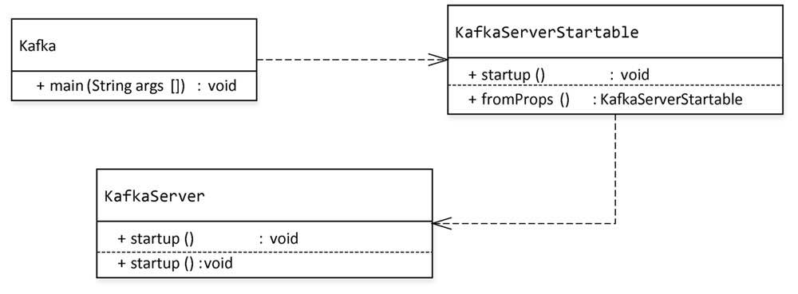
The process of Kafka server starting up
kafka-server-start.sh
Exec $base-dir/kafka-run-class.sh $EXTRA_ARGS kafka.Kafka “$@”
Initialize the components in KafkaServer.startup()
KafkaScheduler
LogManager
SocketServer
ReplicaManager
KafkaController
GroupCoordinator
DynamicConfigManager
KafkaHealthCheck
Update kafka brokerId
Update broker.id in config file server.properties
${log.dir}->meta.properties

Slide 37
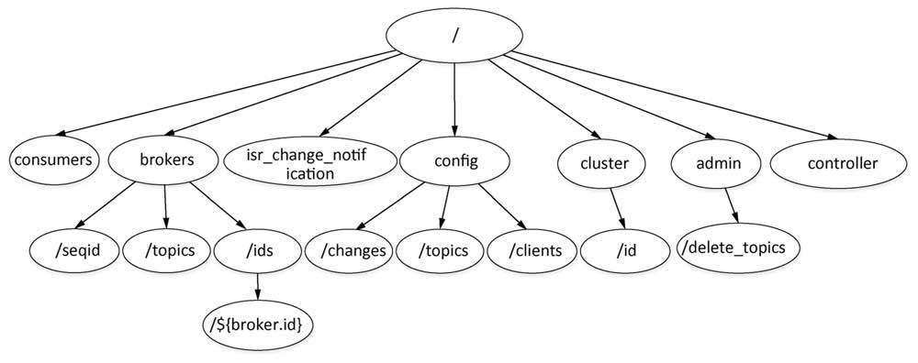
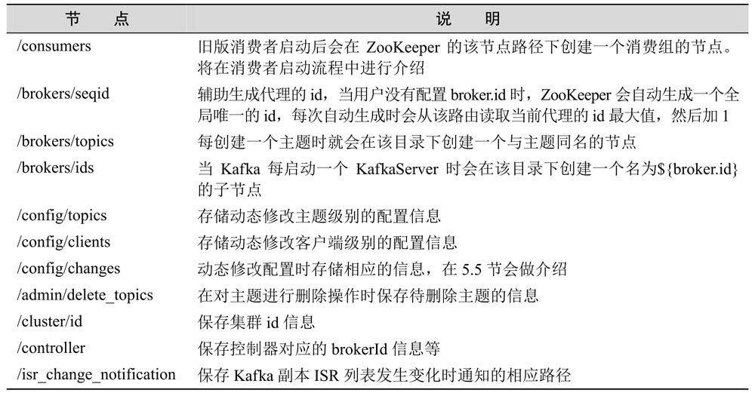

Slide 38
The process of Creating a topic
kafka-topics.sh
Exec $(dirname $0)/kafka-run-class.sh kafka.admin.TopicCommand $@
Partition info will be written in /brokers/topics/${topic-name}/partitions/{partition_number}/state node

Slide 39
The process of Consumer consuming message

Slide 40
The process of Producer sending message

Slide 42
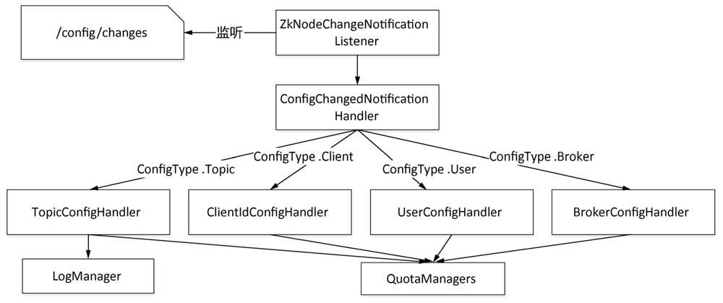

Slide 43
Windows Installation
zookeeper-server-start ..\..\config\zookeeper.properties
zookeeper-shell.bat 0.0.0.0:2181 ( Test zookeeper connection: )
kafka-server-start.bat ..\..\config\server.properties
Linux Installation
Download
Wget http://mirrors.tuna.tsinghua.edu.cn/apache/kafka/2.2.0/kafka_2.12-2.2.0.tgz

Slide 44
Kafka Server
Modify config fiels
Modify zookeeper.properties
Modify server.properties
Start Server
./zookeeper-server-start.sh –daemon ../config/zookeeper.properties
./kafka-server-start.sh ../config/server.properties
Kill kafka server:
ps ax | grep -i 'kafka\.Kafka' | grep java | grep -v grep | awk '{print $1}'

Slide 45
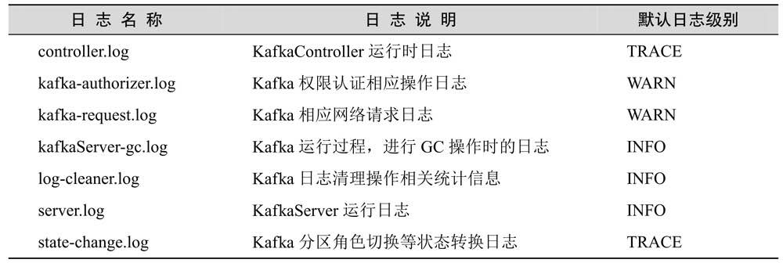

Slide 46
Kafka Topic
--create, --describe, --list, --alter and –delete
Auto.create.topics.enable=true
Num.partitios=1
Default.replication.factor=2
Create a topic
./kafka-topics.sh --create --zookeeper localhost: 2181 --replication-factor 1 --partitions 1 --topic test –config max.message.bytes=404800
List all topic names
./kafka-topics.sh --list --zookeeper localhost: 2181
List topics info
./kafka-topics.sh –describe –zookeeper localhost: 2181
./kafka-topics.sh –describe –zookeeper localhost:2181 –under-replicated-partitions
./kafka-topics.sh –describe –zookeeper localhost:2181 –unavailable-partitions
./kafka-topics.sh –describe –zookeeper localhost:2181 --topics-with-overrides

Slide 47
Kafka Topic
Deleta a topic
Manually delete topic partition folders and login Zookeeper to delete the nodes respectively (/brokers/topics and /config/topics)
./kafka-topics.sh –delete –zookeeper localhost:2181 –topic test (delete.topic.enable=true)
Alter a topic
./kafka-topics.sh –alter –zookeeper localhost:2181 –topic test –config max.message.bytes=2048
./kafka-topics.sh –alter –zookeeper localhost:2181 –topic test –delete-config max.message.bytes
--partition 5

Slide 48
Kafka Producer
Kafka-console-producer.sh
producer.config
producer-property
--property parse.key=true
--property key.separator=‘ ‘
--broker-list
--topic
--sync
Auto.create.topics.enable=true
Num.partitions=1
Default.replication.factor=2
kafka-run-class.sh kafka.tools.GetOffsetShell –broker-list localhost:2181 –topic test –time -1(latest, -2 earliest)
./kafka-console-producer.sh –broker-list localhost:2181 –topic producer-create-topic
./kafka-run-class.sh kafka.tools.DumpLogSegments –files /home/lixing/kafka/kafka/replica-assign-foo-0/00000000000000000000.log

Slide 49
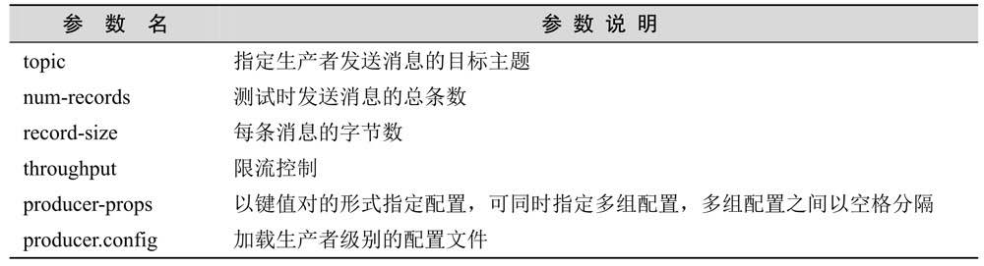
Kafka Producer Performance Test
Kafka-producer-perf-test.sh –producer-props key=value –bootstrap.servers=localhost:2181

Slide 50
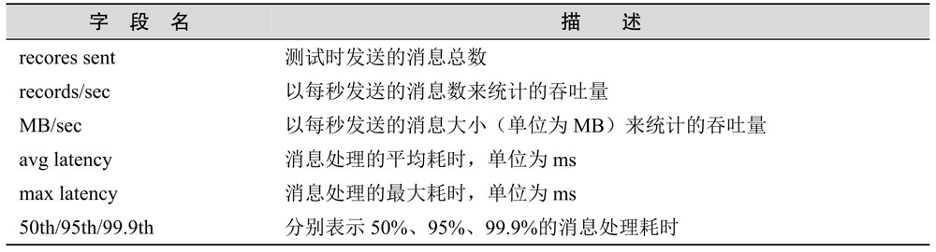
Kafka Producer Performance Test

Slide 52
Kafka Consumer
./kafka-console-consumer.sh -> exec $(dirname $0)/kafka-run-class.sh kafka.tools.ConsoleConsumer “$@”
Group.id
Old High-level consumer: (kafka.consumer.ZooKeeperConsumerConnector)
./kafka-console-consumer.sh –zookeeper localhost:2181 –topic test –consumer-property group.id=old-consumer-test –property consumer.id=old-consumer-c1 –from-beginning –delete-consumer-offsets
Default group.id prefixs with “console-consumer-” and plus an integer within 100000
Default consumer.id is {hostname}-{current-timestamp}-{8bit-UUID}
Old low-level consumer: (kafka.tools.SimpleConsumerShell)低级消费者需要自己管理消费偏移量， 同时只能消费某个主题的某个分区的消息，并不会向Zookeeper注册相应的元素据
./kafka-simple-consumer-shell.sh –broker-list localhost:2181 –clientId simple-consumer-test –offset -1 –partition 0 –topic test

Slide 53
Kafka Consumer
New Consumer： remove the dependency Zookeeper, 不再向Zookeeper注册，而是由GroupCoordinator统一管理， 消费者以消费的offset提交后会保存到内部topic “__consumer_offsets”中。
./kafka-console-consumer.sh –bootstrap-server localhost:2181 –new-consumer –consumer-property group.id=new-consumer-test –consumer-property client.id=consumer-c1 –topic test
./kafka-consumer-groups.sh –bootstrap-server localhost:2181 –list –new-consumer
Math.abs(${group.id}.hashCode()) % {offsets.topic.num.partitions}
查看topic个分区的offsets:
./kafka-run-class.sh kafka.tools.GetOffsetShell –broker-list localhost:2181 –topic test –time -1
./kafka-simple-consumer-shell.sh –topic __consumer_offsets –partition 6 –broker-list localhost:2181 –formatter “kafka.coordinator.GroupMetadataManager\$OffsetMessageFormatter”

Slide 54
Kafka Consumer
Consume Multi-topics
./kafka-console-consumer.sh –bootstrap-server localhost:2181 –new-consumer –consumer-property group.id=consume-multi-topic –whitelist “test1|test2”
SingleCast and MultiCast
./kafka-console-producer.sh –broker-list localhost:2181 –topic test
./kafka-console-consumer.sh –bootstrap-server localhost:2181 –new-consumer –topic test –consumer-property group.id=single-consumer-group
./kafka-console-consumer.sh –bootstrap-server localhost:2181 –new-consumer –topic test –consumer-property group.id=multi-consumer-group

Slide 55
Kafka Consumer
View consumer offsets
./kafka-consumer-groups.sh(kafka.admin.ConsumerGroupCommand)
--zookeeper and –bootstrap-server
OpType: --list, --describe, --delete
./kafka-consumer-groups.sh –bootstrap-server localhost:2181 –describe –group consumer-offset-test –new-consumer
Delete a old consumer group:
./kafka-consumer-groups.sh –zookeeper localhost:2181 –delete –group old-consumer-test

Slide 56
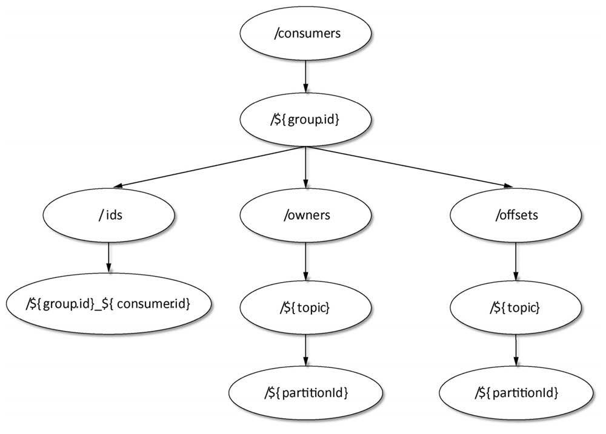
Kafka Consumer

Slide 57
Kafka Consumer Perf Test
./kafka-consumer-perf-test.sh –broker-list localhost:9092 –threads 5 –messages 100000 –message-size 100 –num-fetch-threads 2 –group consumer-perf-test –topic producer-perf-test –new-consumer

Slide 58
Start a Producer
bin/kafka-console-producer.sh --broker-list localhost:9092 --topic test
Start a Consumer
bin/kafka-console-consumer.sh --bootstrap-server localhost:9092 --topic test --from-beginning

Slide 59
Kafka Config Management
./kafka-configs.sh (kafka.admin.ConfigCommand) 用于对配置进行管理，支持两种基本操作： --alter, --describe
--add-config, --delete-config需要与--alter组合使用
使用该脚本需要指定配置类型(--entity-type), 其支持：topics, clients, users and brokers。
同时需要指定配置名(--entity-name)

Slide 60
Kafka Config Management
Topic
./kafka-configs.sh –zookeeper localhost:2181 –describe –entity-type topics –entity-name test
./kafka-configs.sh –zookeeper localhost:2181 --entity-type topics –entity-name test –alter –add-config flush.messages=2, max.messages.bytes=102400
Broker
./kafka-configs.sh –zookeeper localhost:2181 --entity-type brokers –entity-name 0 –alter –add-config follower.replication.throttled.rate=104800, leader.replication.throttled.rate=104800
./kafka-configs.sh –zookeeper localhost:2181 --entity-type brokers –entity-name 0 –alter –delete-config follower.replication.throttled.rate
Users/clients
./kafka-configs.sh –zookeeper localhost:2181 –alter –add-config ‘producer_byte_rate=1024, consumer_byte_rate=2048’ –entity-type users –entity-name Robert
./kafka-configs.sh –zookeeper localhost:2181 –alter –add-config ‘producer_byte_rate=1024, consumer_byte_rate=2048’ –entity-type clients –entity-name Robert(client.id)

Slide 61
Kafka Partition Management
Partition Migration
./kafka-topics.sh –zookeeper localhost:2181 –create –topic reassign-partitions –partitions 3 –replication-factor 1
Create a topics-to-move.json
{“topics”: [{“topic”: “reassign-partitions”}], “version”:1}
./kafka-reassign-partitions.sh –zookeeper localhost:2181 –topics-to-move-json-file ../config/topics-to-move.json –broker-list “1,3” –generate
./kafka-reassign-partitions.sh –zookeeper localhost:2181 –reassignment-json-file ../config/partitions-reassignment.json –execute
./kafka-reassign-partitions.sh –zookeeper localhost:2181 –reassignment-json-file ../config/partitions-reassignment.json --verify

Slide 62
Kafka Partition Management
Partition Leader balance
Auto-balance:
Auto.leader.rebalance.enable=true
{leader.imbalance.check.interval.seconds=300}
{leader.imbalance.per.broker.percentage=10}
Manual balance:
Create a config file partitions-leader-election.json
{
“partitions”:[{“topic”: “test”, “partition”: 1}]
}
./kafka-preferred-replica-election.sh –zookeeper localhost:2181 ../config/partitions-leader-election.json
./kafka-reassign-partitions.sh

Slide 63
Kafka Partition Management

Slide 64
Kafka Security Management

Slide 65
Kafka Mirror Management

Slide 66
Kafka

Slide 67
Setting up a multi-broker cluster
Make a config file for each of the brokers
cp config/server.properties config/server-1.properties
cp config/server.properties config/server-2.properties
Edit these new files as below
config/server-1.properties:
broker.id=1
listeners=PLAINTEXT://:9093
log.dirs=/tmp/kafka-logs-1
config/server-2.properties:
broker.id=2
listeners=PLAINTEXT://:9094
log.dirs=/tmp/kafka-logs-2
Start the two brokers
bin/kafka-server-start.sh config/server-1.properties &
bin/kafka-server-start.sh config/server-2.properties &

Slide 68
bin/kafka-topics.sh --create --bootstrap-server localhost:9092 --replication-factor 3 --partitions 1 --topic my-replicated-topic
bin/kafka-topics.sh --describe --bootstrap-server localhost:9092 --topic my-replicated-topic

Slide 69
CONFIGURATION
Broker Configs
broker.id
log.dirs
zookeeper.connect
auto.create.topics.enable
delete.topic.enable=true

Slide 70
Updating Broker Configs
Alter the current broker configs for broker id 0
bin/kafka-configs.sh --bootstrap-server localhost:9092 --entity-type brokers --entity-name 0 --alter --add-config log.cleaner.threads=2
To describe the current dynamic broker configs for broker id 0

Slide 71
Topics:
Create a topic:
kafka-topics.bat --create --zookeeper localhost:2181 --replication-factor 2 --partitions 3 --topic mytest
List all topics:
kafka-topics.bat –list --zookeeper localhost:2181
View a topic:
kafka-topics.bat --describe --zookeeper localhost:2181 --topic mytest
View offset of a partition:
kafka-run-class.bat kafka.tools.GetOffsetShell --topic luoluo --time -1 --broker-list localhost:9092 --partitions 0
Delete a topic:
kafka-topics.bat kafka.admin.DeleteTopicCommand --zookeeper localhost:2181 --delete --topic mytest
Publish/Produce message console:
kafka-console-producer.bat --broker-list localhost:9092 --topic mytest
Consume message console:
kafka-console-consumer.bat --zookeeper localhost:2181 --from-beginning --topic mytest

Slide 72
Topics:
List consumer group:
./bin/kafka-consumer-groups --bootstrap-server localhost:9092 --new-consumer --list
Check consumer offset for a topic
./bin/kafka-consumer-offset-checker --topic topicName --group groupName --zookeeper localhost:2181

Slide 73
删除topic
删除Zookeeper中的元数据
zkCli.sh进入zookeeper中
Rmr /config/topics/topicname
Rmr /brokers/topics/topicname
Rmr /admin/delete_topics/test
删除磁盘文件
rm -rf $KAFKA_HOME/logs/test-*
调整partition数量
Kafka-topics.sh –alter –zookeeper 192.168.137.191:2181 –partitions 4 –topic test

Slide 74
Monitoring Tools
KafkaManager: https://github.com/yahoo/kafka-manager
删除主题
方式一：手动删除各节点${log.dir} 目录下该主题分区文件夹，同时登录ZooKeeper客户端删除主题对应的节点，主题元素据保存在/brokers/topics和/config/topics目录下
方式二：执行kafka-topics.sh脚本进行删除，如果希望通过该脚本彻底删除主题，则需要保证在启动Kafka的时候所加载的server.properties文件中配置delete.topic.enable=true，该配置默认为false，否则执行该脚本并不是真正删除主题，只是在ZooKeeper的/admin/delete_topics目录下创建一个与待删除主题同名的节点，将该主题标记为删除状态；

Slide 75
3种消费语义
At most once
At least once
Exactly once
Flume --> Kafka --> Spark Srteaming

Slide 76
Partition Strategy
https://github.com/apache/kafka/blob/0.10.0.1/core/src/main/scala/kafka/producer/DefaultPartitioner.scala
对key取hash，然后与topic的分区数量取模，从而得到对应的数据（即消息）应该去哪个对应的分区
2. Zookeeper
https://github.com/apache/zookeeper/

